Slide 1
Week 4 Cohort Class Discussions

Slide 2
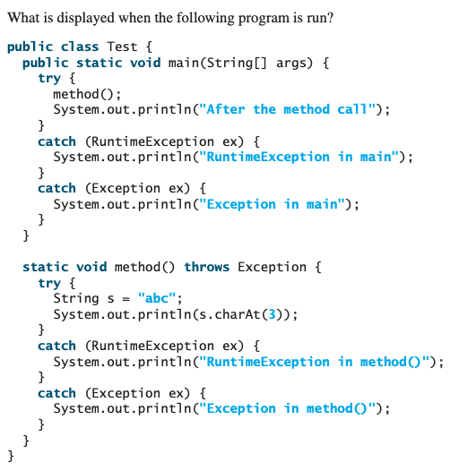
Object
Q2. From Liang, “Introduction to Java Programming”, 10th edition.
Predict the output of the following program and explain your answer.
Throwable
Exception
RuntimeException
IOException
Q1. Complete the UML Diagram above with the following six Exception objects.
Which of these are checked exceptions, which of these are unchecked exceptions?
FileNotFoundException
IllegalArgumentException
NullPointerException
IndexOutOfBoundsException
ArithmeticException
MalformedURLException

Slide 3
Q3.
Why is using a try-catch block here not encouraged and is considered bad coding practice?
Show how you might rewrite the code to avoid using a try-catch block.
public class A { public static void main(String[] args) { try{ String s = getSomeString();
System.out.println(s.charAt(1)); }catch( NullPointerException ex){ System.out.println("Null string returned"); } } public static String getSomeString(){
// code not shown // String is returned but could be null } }

Slide 4
Q4.
1. Why would it be a good idea to declare Bird as an abstract class?
2. Show how you might declare and instantiate a variable that is of type Bird but actual type Pigeon. 3. Show how you might declare and instantiate a List object that can have elements which are any Bird object eg. DomesticDuck, Pigeon etc.
4. Write a class Penguin (can swim, cannot fly) that is subclass of Bird.
5.Notice that the code is duplicated (How?). How might you change the design of the classes to reduce this duplication?
public class Bird { public void fly(){ System.out.println("I CAN fly"); } public void swim(){ System.out.println("I can't swim"); } } class DomesticDuck extends Bird{ @Override public void fly(){ System.out.println("I can't fly"); } @Override public void swim(){ System.out.println("I CAN swim"); } }
class CanadaGoose extends Bird{ @Override public void swim(){ System.out.println("I CAN swim"); } } class Pigeon extends Bird{ @Override public void fly(){ System.out.println("I CAN fly"); } } class Ostrich extends Bird{ @Override public void fly(){ System.out.println("I can't fly"); } @Override public void swim(){ System.out.println("I can't swim"); } }

